Slide 1
Organizational Budget Orientation Meeting
Fiscal Year 2024 – Spring
Andrew Forbes, Senate Finance Committee Chair
Logan Grodsky, Undergraduate Student Body Treasurer
Andrew Gary, Speaker of the Senate
Joshua Alexander, Senate Finance Committee Vice Chair

Slide 2
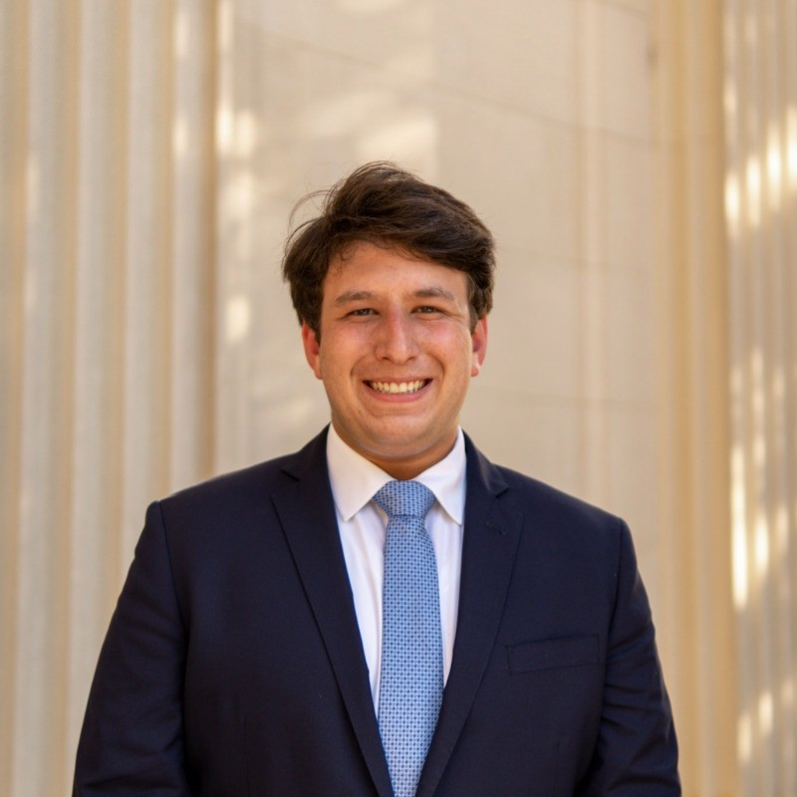
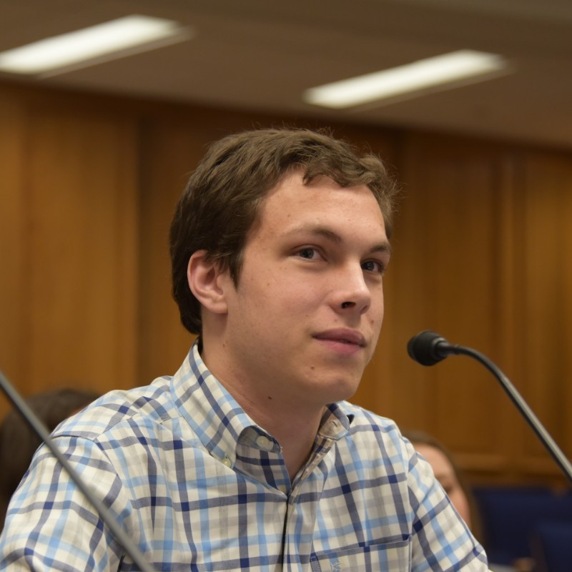
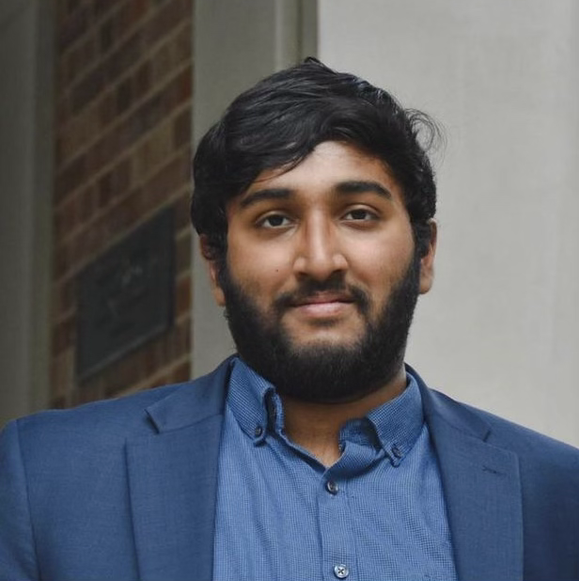
Senator Andrew Forbes
Senate Finance Committee Chair
Logan Grodsky
Undergraduate Student Body Treasurer
Senator Andrew Gary
Speaker of the Undergraduate Senate
Senator Joshua Alexander
Senate Finance Committee Vice Chair

Slide 3
What is the USG funding process?
The Undergraduate Senate appropriates the undergraduate portion of the Student Organizations Fee, approximately $6.00 per student per year.
The Senate conducts this process based on the Undergraduate Financial Regulations, compiled as Title VI of the Undergraduate Student Code.
In order to participate in the USG funding process, you must review and thoroughly understand Title VI. This will be tested for in the Undergraduate Treasurer’s Test.
If you have taken and passed the test in the Fall Semester, you DO NOT need to retake the test to be eligible for funding in the Spring

Slide 4
Requests
The first step of the funding process is to draft your organization’s funding request and to submit it to the Senate. This step is managed by the Finance Committee and its chair.
Hearings
The second step of the funding process is to defend your request to the Finance Committee and to follow it as the Committee generates recommendations and these are considered in the full Undergraduate Senate.
Spending
The final step is to carry out your activities and then to request reimbursement for your expenses. This is handled directly through the Student Controller, carried out by CUSO, and overseen by the Undergraduate Treasurer.

Slide 5
Funding Criteria
Representation: Consider the number of students affected and involved in the project. Anticipate representation by examining past involvement, enthusiasm, and anticipated engagement.
Vitality: Evaluate the program's importance to the organization. Assess its priority among other sponsored programs, fundraising aspects, and impact on organization morale.
Specialization: Examine the uniqueness of the program to the Undergraduate Student Body. Consider cultural/educational value, overlaps with other campus programs, recognition brought to the University, and association with the organization.

Slide 6
Step 1: Budget Submissions
Organizations must submit the Budget Request Form and explanation at https://congress-finance.unc.edu/appropriations/index.php.
Semi-Annual Budget Requests are limited to $15,000.
The window for budget requests will open on January 12 at 5:00 pm, and close on January 14 at 11:59 pm.
You must list each program you plan to use funds for and the amount you are requesting in each funding category (see next slide).
There are also several prohibitions on what may be funded (see ahead)

Slide 7
Funding Categories
Building/Venue Rental: Funds for securing a location, excluding lodging.
Dues and Fees: Funds for paying activity-related fees, excluding prohibited dues or fees.
Equipment Rental: Funds for temporarily renting equipment.
Lodging: Funds for providing accommodation during official activities or travel.
Supplies: Funds for essential tangible goods and materials.
Printing and Publicity: Funds for producing and disseminating printed materials for promotion.
Stipends: Funds for paying undergraduate student government members for their work.
Clothing: Funds for purchasing clothing or costumes for productions.
Travel: Funds for transportation outside of Chapel Hill.
Labor Fees: Funds for paying labor fees, excluding compensation for permanent employees.

Slide 8
Funding Prohibitions
Political: No funding for electioneering or lobbying activities.
Religion: No funds for events promoting religious indoctrination or recruitment.
Future Benefits: No spending for purposes realized in the following fiscal year.
Stockpiling: No purchases beyond immediate operational needs.
Donations: No donations to organizations, except for Undergraduate Speaker honorarium requests.
Food Consumption: No funding for general food consumption, except for approved food insecurity programs.
Firearms and Weapons: Refer to the Student Safety and Security Committee for approval.
Advertisements: No funding for publications or website advertisements, except for campus election candidates.
Retroactive Tax Payments: No retroactive payment for tax-liable services.
Ex-Employees: No salary payments to former employees, except for due settlements.
Individual Gain: No expenditures benefiting only individuals, excluding salaries, stipends, or campaign subsidies.
Alcohol, Tobacco, and Illegal Substances: Strictly prohibited, no exceptions.
Paper Standards: All printed paper must contain at least 30% post-consumer recycled paper.
Dues: No funding for national or superior organization dues.
Gift Cards: No funding for gift cards, certificates, or vouchers.

Slide 9
Application Demonstration

Slide 10
Funding Hearings
The Undergraduate Senate Finance Committee hears requests in two subcommittees on behalf of the Undergraduate Senate.
Finance hearings will be happening on January 23, 24, 25, 27, and 31. Each organization will be randomly assigned to a hearing time slot during these dates.
During the funding hearings, each organization will be given a short interval to present their request and then will be subject to questioning from members of the Undergraduate Senate.

Slide 11
Funding Hearings (cont.)
During you organization’s funding hearing, senators will try to gauge how your request aligns with the objective criteria.
Examples of questions they may ask:
“How many people do you expect to attend your event” (Representation)
“Which of these programs would you prioritize funding for” (Vitality)
“Will more events in this vain be held by other organizations throughout the semester?” (Specialization)

Slide 12
Budget Bill & Full Senate Consideration
After hearings in the Finance Committee are complete, subcommittee recommendations are reconciled to meet the Budget Total and then compiled into a Budget Bill which includes all budgetary appropriations.
The Senate will consider and ultimately vote on the Budget Bill -- once the Senate approves a Budget Bill and it is signed by the Student Body President, you will have access to your appropriated funds.

Slide 13
Expenditure
In order to apply for reimbursement, you must submit the appropriate form at https://heellife.unc.edu/organization/rsofinances.
You should follow all of the steps required in that form and reference the supporting documents on that Heel Life page.
Always make sure to save receipts and other documentation of your expenditures.
If you need help paying for an expense in advance (rather than reimbursement), you should reach out to the Treasurer and the Student Controller well in advance so that they can possibly help you use a P-Card.

Slide 14
Thank you, and questions?

